Slide 1
Demystifying Psychology Discussion Group
The Forensic Interview

Slide 3
Psychology of eyewitness testimony
Eyewitness testimony is a legal term. It refers to an account given by people of an event they have witnessed. ... Eyewitness testimony is an important area of research in cognitive psychology and human memory.
Can be affected by many factors:
Anxiety and stress
Reconstructive memory
Weapon focus
Leading Questions (Loftus and Palmer 1974)
https://www.simplypsychology.org/loftus-palmer.html

Slide 4
Reconstructive memory is a theory of memory recall, in which the act of remembering is influenced by various other cognitive processes including perception, imagination, semantic memory and beliefs, amongst others. People view their memories as being a coherent and truthful account of episodic memory and believe that their perspective is free from error during recall. However the reconstructive process of memory recall is subject to distortion by other intervening cognitive functions such as individual perceptions, social influences, and world knowledge, all of which can lead to errors during reconstruction.
https://www.simplypsychology.org/eyewitness-testimony.html

Slide 5
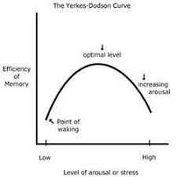

Slide 7
HOWEVER
The Yuille and Cutshall study illustrates two important points:
1. There are cases of real-life recall where memory for an anxious / stressful event is accurate, even some months later.
2. Misleading questions need not have the same effect as has been found in laboratory studies (e.g. Loftus & Palmer).
https://www.simplypsychology.org/eyewitness-testimony.html

Slide 8
Human cognition and the mistakes brains can make
https://www.sciencedaily.com/releases/2011/09/110930153048.htm
Why Eye Witnesses get it wrong – Scott Fraser Forensic Psychologist

Slide 9
