Slide 1
Demystifying Psychology Discussion Group
The Forensic Psychology

Slide 2
What is Forensic Psychology
Forensic psychology is the interaction of the practice or study of psychology and the law. Psychologists interested in this line of applied work may be found working in prisons, jails, rehabilitation centers, police departments, law firms, schools, government agencies, or in private practice, to name a few.

Slide 3
What does a forensic Psychologist do?
Forensic psychologists will often conduct their own research, as well as study and analyse research from other professionals. They may study criminals and their crimes to figure out what traits certain types of criminals have, which may involve interviewing criminals along with their loved ones and victims
The broad definition of forensic psychology emphasizes the application of research and experimentation in other areas of psychology (e.g., cognitive psychology, social psychology) to the legal arena. This would include applying results from studies in areas such as cognitive psychology to legal questions.

Slide 4
Focus
In general terms, forensic psychologists focus on the application of psychological theory and practice to the criminal, court and corrections systems. Forensic psychologists work with the justice system and members of the court to assist in its functioning.

Slide 5
psychopaths
https://blog.allpsych.com/psychopaths-dont-care-about-cute-animals/

Slide 6
Psychology of Stalking
https://www.abc.net.au/radionational/programs/allinthemind/the-psychology-of-stalking/3385910

Slide 7
The Difference Between Sociopathy and Psychopathy
The terms psychopath and sociopath are often used interchangeably, which causes much semantic confusion, as there are differences each term. It is important to understand that the fifth edition of the Diagnostic and Statistical Manual of Mental Disorders (DSM-5) formally classifies both psychopathy and sociopathy as antisocial personality disorder (ASPD). Those terms are used by the lay public far more than is the ASPD designation, however. Here's a breakdown of all three labels and why some are used more often than others, depending on the clinical picture.
Antisocial personality disorder (ASPD)
Traits of a sociopath
Traits of a psychopath
https://www.psychologytoday.com/au/blog/happiness-is-state-mind/201902/the-difference-between-sociopathy-and-psychopathy

Slide 8
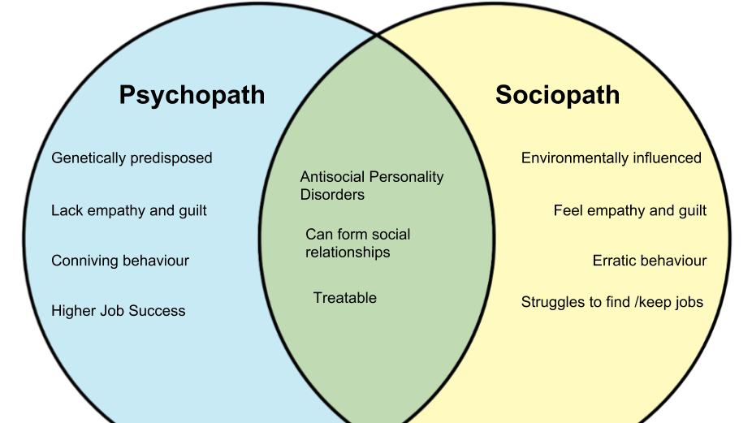

Slide 9
Interviewing a Psychopath - circa 1961

Slide 10
Interviewing a Psychopath – circa 2018

